Slide 1
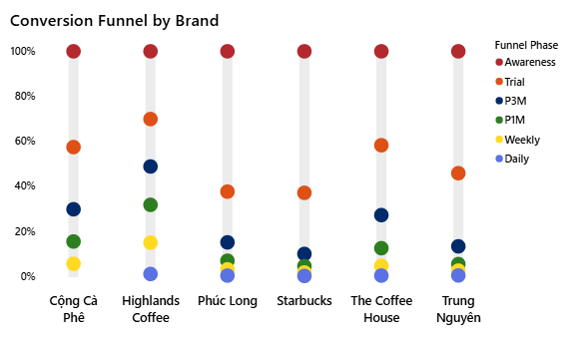
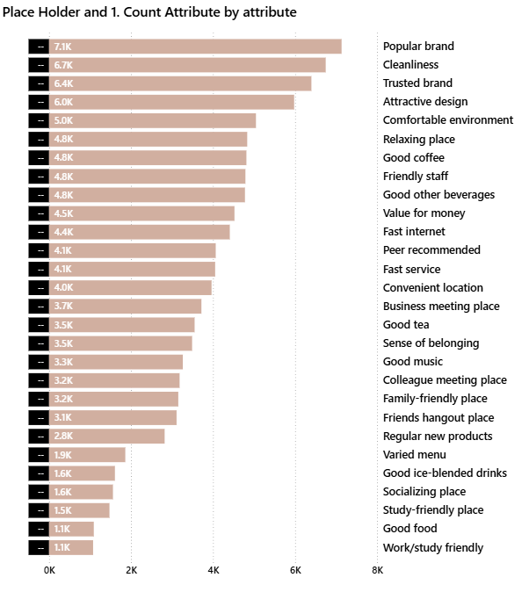
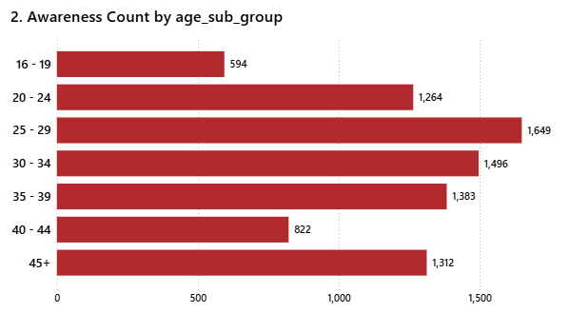
Conversion Analysis Dashboard
Uncover key leakage points and understand what drives or hinders customer retention.

Slide 2
Competitive Landscape Dashboard
Uncover key leakage points and understand what drives or hinders customer retention.
Overview

